Slide 1
Mobile Computing
By Madiha Hameed

Slide 2
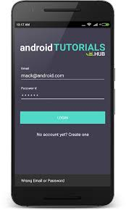
Introduction
Today we learn how to create a login page in android application

Slide 3
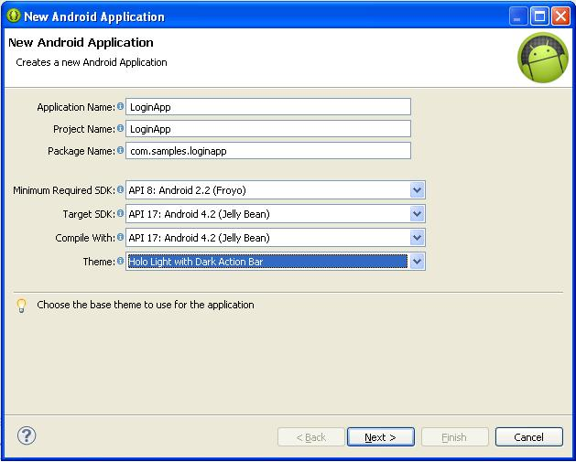
Steps to start in Android Studio
Step 1

Slide 4
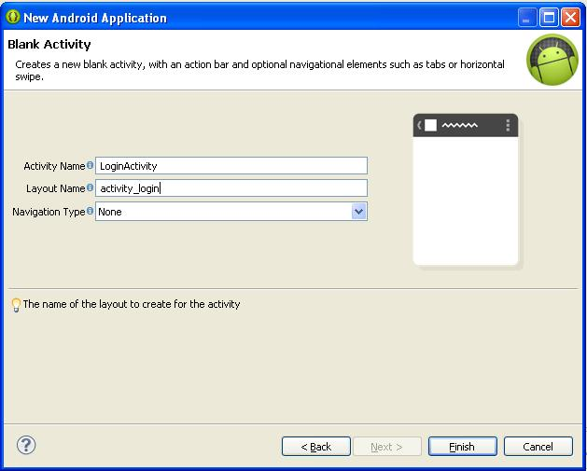
Step 2

Slide 5
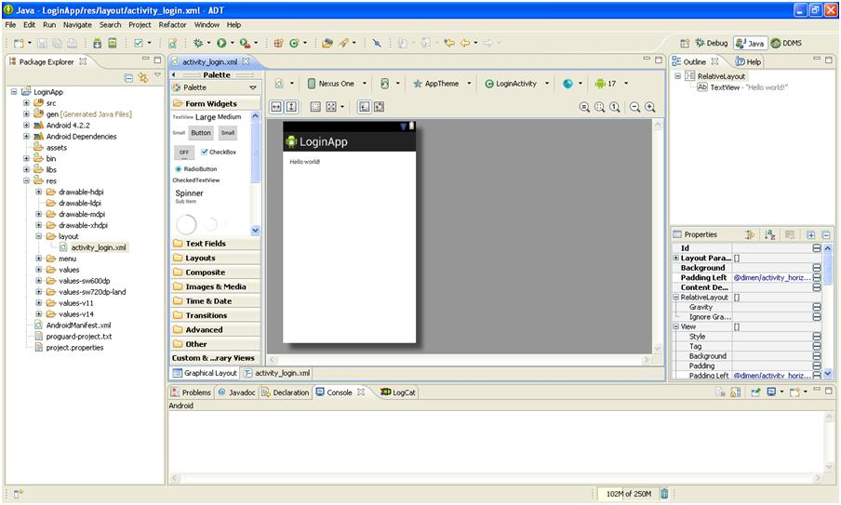
Step 3

Slide 6
Take input from user
<EditText
android:id = "@+id/username“
android:layout_width = "wrap_content“
android:layout_height = "wrap_content“
/>
<EditText
android:id = "@+id/password“
android:layout_width = "wrap_content“
android:layout_height = "wrap_content“
android:inputType = "textPassword" />

Slide 7
Submit the request
<button
android:id = "@+id/button“
android:layout_width = "wrap_content“
android:layout_height = "wrap_content“
android:onClick = “Login”
android: text = "@string/Login"
/>

Slide 8
Link The Code
EditText username = (EditText)findViewById(R.id.editusername);
EditText password = (EditText)findViewById(R.id.editpassword);
public void login(View view) {
if(username.getText(). toString().equals("admin") && password.getText() ().toString().equals ("admin")){
//correct password
}
else{
//wrong password
}
}

Slide 9
MainActivity.java.
package com.example.sairamkrishna.myapplication;
import android.app.Activity;
import android.graphics.Color;
import android.os.Bundle;
import android.view.View;
import android.widget.Button;
import android.widget.EditText;
import android.widget.TextView;

Slide 10
public class MainActivity extends Activity {
Button b1,b2;
EditText ed1,ed2;
TextView tx1;
@Override
protected void onCreate(Bundle savedInstanceState) {
super.onCreate(savedInstanceState);
setContentView(R.layout.activity_main);
b1 = (Button)findViewById(R.id.button);
ed1 = (EditText)findViewById (R.id.username);
ed2 = (EditText) findViewById(R.id.password);

